Slide 1
SYSTEMIC CHANGE in Graduate Education: Designing For Equity
Presenter Names: Affiliation
Presenter Names: Affiliation
Notes:
Online format, 120 minutes

Slide 2
today
Objectives & norms for today’s session
Shared language
Positive case studies of systemic change Applications & planning for our programs
Baobab tree
Notes:
Main point: Ensure the overall agenda for today and time together is clear

Slide 3
Objectives & Norms

Slide 4
purpose
We are here to begin reimagining & redesigning how we select & serve graduate students.
objectives
Understand the roles of culture & system change in equity in graduate education.
Appreciate systemic relationships among domains of faculty practice.
Reflect on cases of PhD programs that have realized deep change.
Apply lessons toward a coordinated approach to change in your own program or department.

Slide 5
norms
We may mute you to avoid background noise.
You will need access to Google Drive for a shared notes document.
Reflection & discussion are integral to individual & organizational learning; today’s activities will center on these activities.
Type questions into the chat to the host; we’ll revisit them periodically.
We will use break out rooms for two short discussions.
Notes:
Main point:
Acknowledge that a online context requires us to have some shared norms for use of technology, ensure that people are ready to use Google Drive for a couple of activities, and that much of our activity will be anchored on reflection and discussion.

Slide 6
group behaviors
CONSTRUCTIVE
DESTRUCTIVE
Cooperating
Clarifying
Inspiring
Harmonizing
Risk Taking
Process Checking
Dominating
Rushing
Withdrawing
Discounting
Digressing
Blocking
Notes:
Main point: We all come to events like this with our own behavioral tendencies, and it’s important to recognize how we’re positively contributing to an environment conducive to discussion about issues that surround race, gender, equity, power, and privilege. Encourage attendees to take a moment to read through these two lists, and to jot down for themselves as intentions at least one constructive behavior they will try to bring, particularly to breakout discussions, and at least one destructive behavior that might be a tendency, which they will try to keep in check.

Slide 7
Shared Language
Notes:
Main point: We come to a workshop like this from a variety of perspectives and experiences and background knowledge. These affect how we think, how we engage in a session like this, how comfortable and affirmed we feel. Even among academics who are committed and relatively knowledgeable, we can bring fundamentally different understandings of key ideas to the table, and if we don't develop some shared language, it can create misunderstandings that are more thorny to navigate because we are talking about issues that political and important to our identities. So, we’ll start today by developing shared language.

Slide 8
What does equity mean to you?
Notes:
CHAT THE LINK TO A NOTES DOC, POLL EVERYWHERE, OR GOOGLE JAMBOARD.
Main point: To get us started, take the next minute to take some notes about what equity means to you.

Slide 9
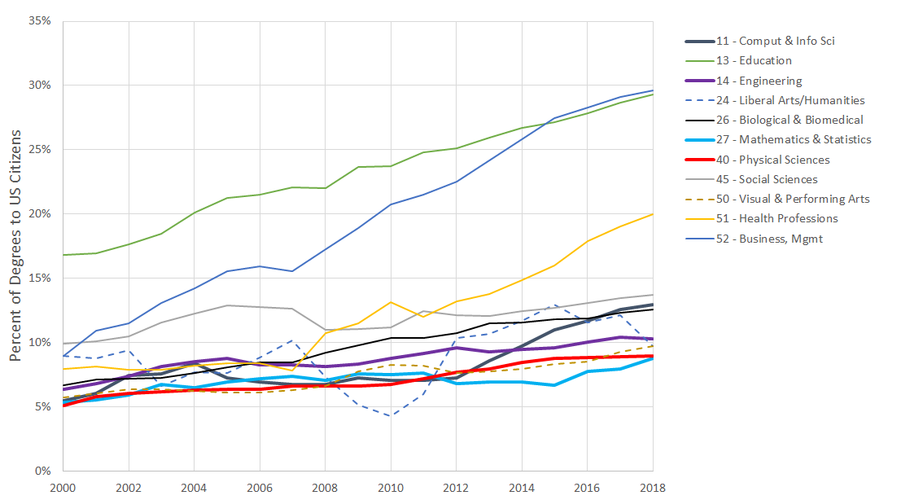
Percentages of Doctoral Degrees Awarded Over Time to Black/ African Americans, Hispanic/Latinx, and Native American/ Alaska Natives
*Selected Academic Fields, 1997-2017. Includes students who are citizens or permanent residents and self-identify as African American (non-Hispanic), Hispanic, or American Indian/Alaska Native. Source: U.S Department of Education, Institute of Education Science, National Center for Education Statistics, Integrated Postsecondary Data System. Data were accessed via the National Science Foundation’s online data system.
Notes:
Main Point: When statistics are our measurement instrument, then this sort of data logically becomes the way that we identify equity and inequity in academia. But it’s not that simple; one of the root causes of these persistent inequities is the culture of our disciplines and departments.

Slide 10
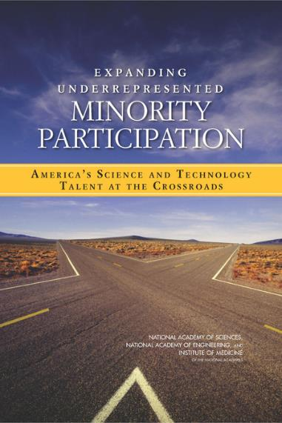
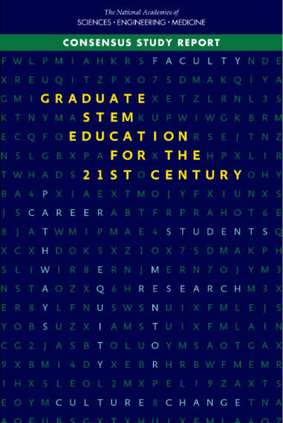
NASEM reports consistently point to graduate study as a necessary investment & intervention.
The most recent NASEM reports point to a need for cultural and systemic change in graduate education.
2011
2018
2021
Notes:
Main point: The National Academies is increasingly recognizing cultural issues in STEM alongside of-- and as root causes of-- underrepresentation.
Their 2011 report Expanding Underrepresented Minority Participation called for a redoubling of efforts to broaden participation, and their 2018 report Graduate STEM Education for the 21st Century highlighted the need for a student centered approach to graduate education. It noted that both departmental

Slide 11
shared language
Equity is
"RECONFIGURING STRUCTURES, CULTURES, AND SYSTEMS TO EMPOWER MARGINALIZED GROUPS AND CLOSE DISPARITIES"
(POSSELT, 2020, P. 2).
It is a process, not an achievement or a box that can be checked.
Notes:
Main point: Against this backdrop of the need to address both patterns of participation and the culture that contributes to it, we can define equity as on the slide. It’s better to think of equity not as some goal that can be checked off a list, but as a process -- that both closes disparities represented in line and bar graphs and that empowers groups that have been historically marginalized.

Slide 12
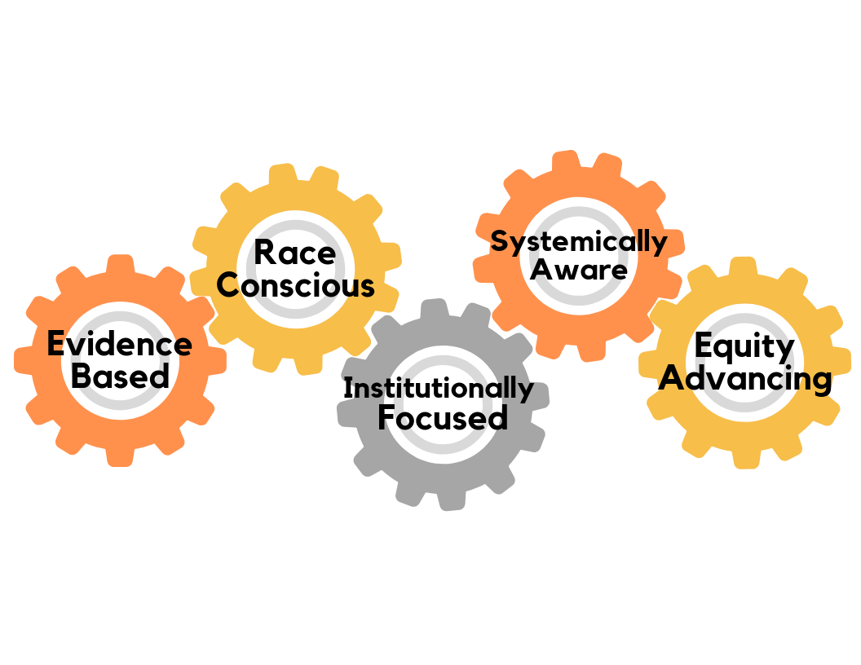
What does equity-mindedness entail?
Bensimon et al.
https://cue.usc.edu/about/equity/equity-mindedness/
Notes:
Main point: A powerful perspective on equity for those of us in higher education is offered by Estela Bensimon and her colleagues. Equity mindedness is the perspective displayed by practitioners who are able to call attention to inequities in outcomes and take responsibility for addressing the practices that contribute to them. The five gears represent elements of equity-mindedness that work together shift power relations.
Facilitators can read more about the elements of equity minded elements here: https://cue.usc.edu/about/equity/equity-mindedness/

Slide 13
shared language
Culture is
a system of inherited values, goals, & language that provides members with shared identity and purpose
Cultures surface in predictable ways.
How goals are defined and pursued
Which groups’ interests are served in evaluative criteria & decision-making
What expectations are placed on new members & leaders (ie, socialization)
Cultural change is an essential part of equity.
To not only close gaps, but also keep them closed.
To attend not only to who is present, but also the distribution of power and quality of everyday experiences.
Notes:
Main point:
Another critical concept is culture, which can be defined as a system of inherited values, goals, and language that provides a group’s members with shared identity and purpose for their work.
You can notice culture in action because it tends to surface in predictable ways: How goals are defined and pursued; Whose interests are served in evaluative criteria & decision-making processes; What expectations are placed on new members & leaders. Social scientists call the process of learning a group’s culture socialization.
We need to take culture seriously if we want a robust conception of equity that will not only close gaps, but keep them closed and that attends not only to who is present, but to distribution of power.

Slide 14
Few women or people of color enrolled
The study of culture often exposes feedbacks & dependencies, which are two clear signals of a system.
Students enroll elsewhere.
Program admits a few individuals, but does not question its culture
Admitted students see lack of critical mass & pick up on negative climate
Notes:
Main point: If you start paying attention to culture, you may notice there are feedbacks and dependencies, such as the negative feedback loop presented here, which is common in PhD programs that are interested in creating diversity, but not questioning the culture that has produced inequitable representation. Anytime you see feedbacks like this, it’s a signal that you’re in a system.

Slide 15
shared language
System
a set of elements connected by dependencies and interactions– internally and with the environment– that helps to achieve something.
Graduate education is a complex system.
Recruitment, admission, curriculum, pedagogy, and mentoring are not independent, but rather an interconnected system.
A starting point for redesigning is recognizing what the current system of graduate education is calibrated to achieve.
Notes:
Main point: This brings us to the definition of a system, which is important to be clear on for a workshop about systemic change. A system, most fundamentally, is a set of elements that are connected by dependencies and interactions with each other and with the environment, that helps to achieve something. When we recognize how areas of practice are connected, we are starting to think systemically. And when we recognize what the current system is calibrated to achieve, we have a good starting point for redesign. The more we think of student learning as the goal of graduate education, the better for equity because we won’t privilege people who come to graduate school with the skills and knowledge it was designed to develop.

Slide 16
poll 1
What is the central goal of graduate education, currently?
Producing the next generation of faculty
Student learning
Advancing disciplines & fields of study
Research assistance for faculty
Inexpensive teaching for undergraduates
Notes:
Without learning as a central goal if not the central goal, grad ed is basically a production enterprise. And it may be that, but remainder of today, I will take as an assumption that even if grad ed does all these things, that we can much more easily embed equity in what we do when we rebalance so that student learning is more emphasized as a goal.

Slide 17
QUESTIONS

Slide 18
Case Studies of Change in PhD Programs
Notes:
Main point: In this section, we will present two case studies of PhD programs that have become significantly more diverse over time. These are real departments in a prominent research university.
Note to facilitators: We recognize the story telling aspect of sharing case studies can be challenging. You can present the cases in one of two ways:
Slide notes contain a narrative that you may choose to present in your own words aloud
This document contains the same narrative, and you can make it available via chat or handout, then go right into breakout rooms where participants to read to themselves (or aloud to one another) and discuss the questions on slide 31.
https://docs.google.com/document/d/1rXEGkQEMIDQdvcg5AAZSy5frw0A1W722suyRuRxf8dE/edit?usp=sharing
If you choose to do the latter, you will probably want to introduce the figure on slide 20 before going into breakout rooms.

Slide 19
case studies of change efforts
Discipline/Field | Focus of equity effort | Level of Analysis
Applied Physics | Race & Gender | PhD Program
Chemistry | Gender | PhD Program
Civil Engineering | Gender | PhD Program
Psychology | Race | PhD Program
Astronomy | Race & Gender | Disciplinary society
Physics | Race | Disciplinary society
Geology | Gender | Field Course
Notes:
For context (not necessarily for presentation), these cases are two of seven presented in Equity in Science.

Slide 20
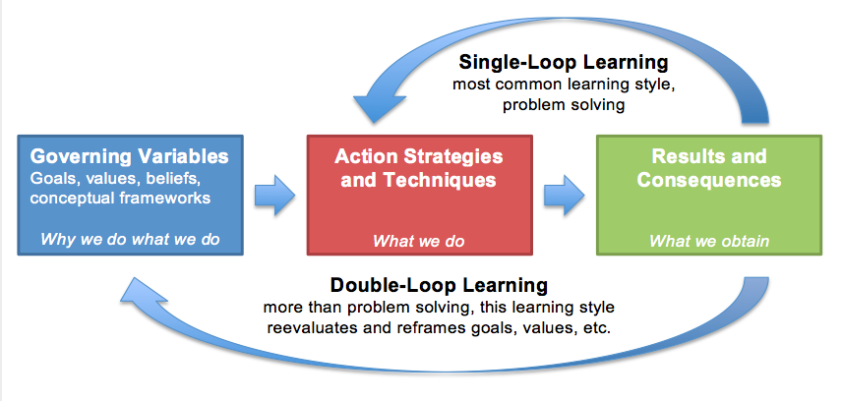
case studies
While listening to details of the cases, consider whether they are stories of single-loop or double-loop learning.
Notes:
Main point: Here is a visual depiction of the difference between single and double-loop learning that was introduced a few minutes ago. You can see that both types have results, but that while single loop learning emphasizes change in actions and what we do, double loop learning also examines the goals, values, and beliefs that motivate what we do. As we are sharing the details of this case, we’d like you to consider whether you think it is a story of single or double learning and why.

Slide 21
Case 1: Equity Work as a Virtuous Cycle of Organizational Learning Discipline: Chemistry Objective: Gender equity
case studies
Posselt, J., Porter, K. B., & Kamimura, A. (2018). Organizational pathways toward gender equity in doctoral education: Chemistry and civil engineering compared. American Journal of Education, 124(4), 383-410.
Notes:
Main point: The first case study is of a chemistry department that was working to improve gender equity. It offers an example of organizational learning over time toward gender equity in both its faculty and student populations.

Slide 22
Case Details
“A head-hanging embarrassment”: The departments ranking sank amid multiple failed tenure cases for women
A groundswell for change in the 1990’s: “This isn’t who we are.” Or is it?
A step back: Coordination with the ADVANCE program to systematically investigate what was going on.
A systematic change effort: Changed evaluation & hiring practices
A “watershed moment”: hiring ”the top candidate in the country her year, of any chemist.”
Optimism & development of a critical mass of new women faculty.
Posselt, J., Porter, K. B., & Kamimura, A. (2018). Organizational pathways toward gender equity in doctoral education: Chemistry and civil engineering compared. American Journal of Education, 124(4), 383-410.
Notes:
Main point: The story of this chemistry department’s journey toward gender equity in graduate education is inextricably connected to their journey toward recruiting and retaining well‐respected female faculty. The groundswell for change developed in the late 1990s from recognition that the department’s national reputation was suffering due to a number of failed tenure cases among female faculty. Morale was low, and one member called it a “head hanging embarrassment.” By taking a step back with the support of an ADVANCE grant and examining data about their practices for hiring, tenure, and promotion the department began making systematic policy changes that resulted in hiring and retaining excellent female faculty.

Slide 23
case studies
“Critical mass went a long way to organically attracting women PhD students.”
Attention to experiences and “small cues” sent in recruitment and within lab life.
Questioning their goals, values, & strategis enabled recognition that they’d been short-sighted.
For example: Hiring women as “diversity hiring” vs. Hiring women in the intellectual core of the department.
The department became known for being “friendlier to women, particularly in certain areas like organic synthesis which is typically really macho.”
Notes:
Main points: Along the way, their attention to the department culture and the attainment of a critical mass of women faculty went a long way to attracting women PhD students organically. One way they paid attention to their culture was by noticing how they argued for women in the department at all. They recognized for example that treating women as “diversity” would marginalize them more than hiring and admitting women into the core of the department. This kind of attention to their own thinking and to small cues sent in recruitment activities made the department more welcoming to women in their recruitment efforts.

Slide 24
case studies
v
Enabling a virtuous cycle of learning
Improving policies, representation, and the climate for women faculty made it natural to take on the improvement of equity for graduate students.
Now, they are taking on institutionalized racism. They are more confident and skilled in addressing racial inequities in both the faculty and student populations.
Possibilities that come with
-A goal of equity (vs. diversity)
-A strategy of organizational learning
Notes:
Main points: The department faculty learned from their experience transforming systems for recruiting and retaining faculty, and took the lessons learned into improving systems for recruiting and retaining graduate students. They are effectively encouraging a virtuous cycle of learning. Today, the department is extremely intentional when it comes to recruitment, thinking through such details as who is seated beside who at dinners during campus visit weekend, prominently displaying photos of whole research teams and members of professors’ families. In addition, they have made bold moves in admissions, eliminating GRE score requirements and conducting a thoughtful and systematic holistic review of every applicant by faculty members with expertise relevant to applicant research interests.

Slide 25
Which organizational learning type best describes this case?
Poll 2
Single-loop learning
Double-loop learning

Slide 26
Case 2: Equity Efforts as Boundary Work
Discipline: Chemistry Objective: Racial equity
Posselt, J. R., Reyes, K. A., Slay, K. E., Kamimura, A., & Porter, K. B. (2017). Equity efforts as boundary work: How symbolic and social boundaries shape access and inclusion in graduate education. Teachers College Record, 119(10), 1-38.
Notes:
Main point: The second case study is of an applied physics program that was working to improve racial diversity and then equity. It offers an example of organizational boundary work over time, and of connecting different areas of practice.

Slide 27
Case Details
Michigan Mandate: Aimed at increasing faculty diversity by coupling diversity and excellence
Visionary Leadership of Roy Clarke, the program’s first director.
Leaders redesigned core elements of the program to create conditions that would be help facilitate equity & inclusion.
Reimagining their identity relative to a ‘typical physics department’ where cultural boundaries = barriers
Redesigning policies and practices accordingly
Posselt, J., Porter, K. B., & Kamimura, A. (2018). Organizational pathways toward gender equity in doctoral education: Chemistry and civil engineering compared. American Journal of Education, 124(4), 383-410.
Notes:
Main point: The applied physics program at the University of Michigan designed from the ground up to align with a major university initiative called the Michigan Mandate that was aimed at increasing faculty diversity by coupling diversity and excellence rather than seeing them as a trade-off. They had a visionary leader as their first director. Roy Clarke came from England, and noticed that the culture of physics seemed more cold and impersonal here than there. He made it his goal to rethink some of the core elements of a program to create conditions that would facilitate equity and inclusion. What this looked like in practice was reimagining their identity relative to a typical physics department where the boundaries on key values and practices -- things like the ideal graduate student, the curriculum, and relationships -- operated more like barriers to minoritized students.

Slide 28
case studies
DOMAINS OF BOUNDARY CHANGE & PRACTICES REDEFINED
Intellectual goals of applying theory to problems → individualized, interdisciplinary curriculum
Notion of the “ideal student” as “intellectually adventurous” → admissions & recruitment
Role of administrative staff → respecting cultural translation as leadership
Family-like relationships in the program → support & climate that was a competitive advantage
”The great power of physics is that it can be used to solve problems, to develop new technologies, to understand complicated interactions.”
-Former Director
Notes:
There were four specific areas where they tried to rethink the boundaries on what was important to them, and they reformed associated areas of practice accordingly. They institutionalized a flexible, interdisciplinary intellectual paradigm that privileged application of knowledge in physics to societal problems. In addition, to identify students who would fit their distinctive intellectual focus, the program reconceptualized what counted as the “ideal graduate student”. Rather than seeking conventional academic achievers, they valued the intellectually adventurous, and once they had this understanding reformed their admissions process to reflect this ideal, focusing on students’ research interests, record of risk-taking in coursework, and creative thinking. Third, the program empowered administrative assistants to play important roles; by functioning as cultural translators and agents of faculty learning, staff provided students with supportive advocacy and helped develop professors’ capacity for cross-racial mentoring. Finally, faculty, staff, and students alike went out of their way to cultivate trusting, caring, family-like relationships. More than a cliché or tagline, “the family” was a shared identity within this program, one that created a climate which provided their with a competitive advantage over other physics departments around the country. What these themes have in common is that they reflect an effort to redefine the boundaries on the knowledge and student qualities that are valued; the roles, status, and responsibilities expected of community members; and the nature of their relationships with one another.

Slide 29
case studies
Few women or people of color
Recall this feedback loop...
Students enroll elsewhere.
Program admits a few such individuals, but does not question the rules.
Admitted students see lack of critical mass & pick up on climate cues
Notes:
Main point: You may recall this negative feedback look from earlier in the workshop today. [Don’t need to go over it in detail, just leave up as a reminder for a few moments]

Slide 30
case studies
We learn from applied physics the potential of reimagining standard practices as levers for equity.
Evaluation & Assessment
Recruitment
Admissions
Climate & Mentoring
Notes:
Main point: What we learn from applied physics is the potential that comes with reimagining standard practices as lever for equity. As they engaged in coordinated improvement across areas of practice, taking into account who was privileged and disadvantaged under the definitions of the values that motivated their actions, they were able to engrain a culture of equity work as normal.

Slide 31
 | Definition | Learning approach | Potential equity outcomes
REFORM | Improvement through the removal of faults or abuses | Single loop learning emphasizes problem solving | Representation
TRANSFORM | Thorough or dramatic change, including recreation | Double loop learning re-evaluates & reframes goals & values toward desired outcomes | Culture
Notes:
Main point: Systemic change is transformational. What it looks like is different than reform, which is just about removing faults of the system and changing what we do. Those activities might be able to change representation in the short term, but it won’t be systemic change without paying attention to our goals and motivations-- why we do what we do. In the case studies in the next section, we’ll discuss two examples of change and we’ll ask you to think about whether they seem more like reform or transformation; first-order or second order change; single or double loop learning.
Note: these align with first and second order change as discussedin the AIP Team Up report.

Slide 32
Introduce yourselves
Identify a notetaker & a timekeeper (Equity check: be mindful of who typically plays these roles, and please consider stepping up if you are not usually one of them.)
Discuss:
What was systemic about change in each of these cases? What feedbacks or dependencies might there be among your curriculum, admissions, recruitment, leadership, and climate?
What was cultural about change in each of these cases? What values, priorities, or goals are being debated/ negotiated in your program?
What is at least one nugget that you or your own graduate program can learn from either of these cases?
What resources would you need to make changes like these programs?
4. Please log your answers to questions c &/or d
bit.ly/3t1TIBj
Activity 2:
Discuss Case Studies
20 minutes
Notes:
LINK FOR LOGGING NOTES:
https://docs.google.com/document/d/1KzalwC2FjALg7maMLEaaYiC8KXVIzYkSRe9lZRCddhI/edit?usp=sharing

Slide 33
DISCUSSION/ QUESTIONS

Slide 34
APPLICATIONS
Notes:
Main note: Now we are going to move into a discussion of how to apply lessons from these programs to our own. To start, we’ll share some high level perspectives about the multiple forces for change and multiple levels of analysis and activity that are possible in pursuing systemic change in STEM PhD programs. Then we’ll move into an activity where you can begin mapping out with your colleagues an equity challenge that your program faces, and how you might systemically address it.

Slide 35
applications
BOTTOM UP
TOP DOWN
INSIDE OUT
-Advocacy & critique from community
-Pressure on organizational leaders
-Individual reflection & collective learning about inherited norms, practices, narratives for inequality.
-Data (both numbers & stories) are a powerful resource.
-So is an environment of trust & respect.
-Institutionalization depends on resources & coordination.
-Coordination and management must themselves be carried out equitably & inclusively.
Forces for change in complex organizational systems
Notes:
Main point: Many of us are familiar with top down and bottom up change, but in the programs that have been able to sustain more diverse and equitable outcomes over time, members also practiced inside out change-- engaging in reflection and collective learning about the norms and practices that they had inherited, as well as their typical stories for inequality. They used data in the form of both numbers and stories, and carried out these important discussions in an environment of trust and respect.

Slide 36
applications
MICRO
MESO
MACRO
-Change in habits, interactions, thought patterns.
-Importance of equity-mindedness
-Normative practices in “discretionary spaces” (Ball, 2018)
-Policy frames what is possible for organizations
-Institutional, society-level, state, federal policies all affect graduate education
-“Where the action is.”
-Standard operating procedures
-Practices are flexible to change, if you can manage the dialogue & personalities
Levels of analysis in complex organizational systems
Notes:
Main point: Another type of multiplicity to pay attention to is the different levels of activity and analysis where change is often needed. This is also worth paying attention to because in our organizations, we might feel limited or challenged in making change in at least one of these levels -- whether it’s a difficult policy environment, difficult department politics, or difficult individuals. That doesn’t have to stop us from acting on other levels.

Slide 37
Primary Drivers:
Root causes of the challenge
Solution Drivers: Steps to undermine primary drivers
Challenge
Challenge:
Objective:
Notes:
Main point: With this perspective in mind, we’re going to move into a planning activity that gets us talking and thinking in specific terms about an equity challenge.

Slide 38
Problem & Objective
Causes of problem
Hypothesized solutions
Faculty mindsets that present barriers to change & diversity.
Identify faculty mindsets, make a case for change that meets faculty where they are.
Problem:
Current admissions practices pose barriers to women & ethnic/racial minority applicants.
Objective: Increase numbers of ethnic/ racial minority & women admitted to partner programs.
Professional societies communicate value of diversity (e.g. ask programs to report diversity measures, recognize excellent programs).
Perceived lack of time to fully consider volume of applications received.
Provide faculty with current admissions research & means of efficiently gathering needed information.
Perceived risk of admitting applicants from unfamiliar undergraduate programs.
Encourage rejected URM applicants to apply to APS Bridge Program or other options.
Mismatch between applicant preparation and graduate program requirements.
Improve program flexibility (e.g. allow students to take undergraduate courses to fill in gaps).
Ad hoc admissions review (lack of protocols or shared norms).
Offer admissions committees opportunities to develop program-specific admissions rubrics.
Implicit biases of committee members or in reference letters.
Provide faculty with research & self-assessments about implicit biases & strategies for how to correct them.
Misuse of GRE scores and GPA.
Offer admissions committees training on holistic evaluation.
Lack of understanding of non-cognitive measures and lack of appropriate tools.
Report correlations of admissions data and PhD completion.
Develop non-cognitive assessments that are easy to use and offer faculty training.
Notes:
From IGEN project planning

Slide 39
Identify a new notetaker & a timekeeper.
The notetaker will find instructions on the workshop google doc. They should either 1) share their screen if possible or 2) follow the instructions to create a shared doc that all can see from their own computers.
Discuss:
A- Pick a set of issues in your program that would benefit from reimagining: -admissions & recruitment
-curriculum & transition to candidacy
-mentoring & climate
B- Articulate a challenge of diversity, equity, or inclusion in that area. Articulate a measurable objective.
C- Brainstorm root causes of the challenge, either in general or in your organizational context.
D- If you get to it, brainstorm steps you could take to address those root causes. Be creative! (Hint: Think about micro, meso, and macro steps, as well as bottom-up, top-down- and inside out forces). Draw arrows from each step to the root causes it may undermine.
3. Consider sharing your driver diagram with the Grad Division.
Activity 3:
30 minutes
Notes:
Chat the link for logging notes. Instructions also found here.

Slide 40
Share the results of
your driver
diagramming.

Slide 41
CONCLUSIONS

Slide 42
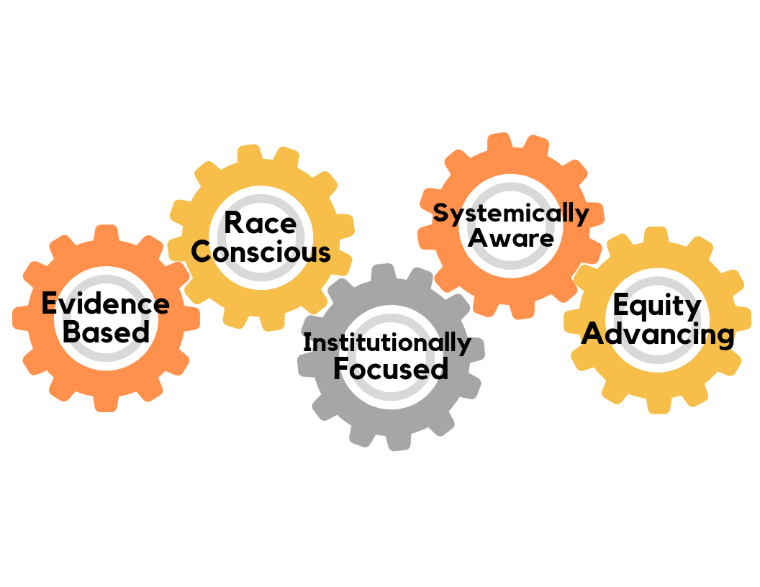
Equity-minded checks on your systemic change planning process
-Are you clear on your objective(s)?
-How are representation, practice, and culture each addressed as aspects of equity?
-How will your plans empower historically marginalized groups? Which ones?
-How can data inform design, implementation, and evaluation?
-How are you consider student level & program level data? Over time?
-How do statistics & stories complement each other as forms of data?
-Who is at the table? Are you attuned to this work as racialized?
-Are you talking about manifestations of racism?
-Whose voices, needs, and interests are centered?
-You may work with central tendencies, but beware of essentializing
-Do your root causes and hypothesize solutions represent micro, meso, & macro levels?
-How are you accounting for bottom up, top down, and inside out influences?
-Are you explicitly naming interactions among areas of practice?
-How do your formulations of the problem center institutional responsibility?
-How are you engaging relevant stakeholders at your institution?
-How can you build a sense of collective responsibility?

Slide 43
conclusions
v
What is next?
The kind of discussion to complete a driver diagram is what organizational theorists call sensemaking: collective interpretive work that decides what is most meaningful and enables us to get on the same page about the nature of our challenges and angles toward solutions.
Sensemaking that’s attuned to power & privilege is essential for change; this distinguishes it from strategic planning.
Bring your driver diagram, back to your colleagues.
Continue the conversation, continue learning, continue organizing for change.
Aromaa, E., Eriksson, P., Mills, J. H., Hiltunen, E., Lammassaari, M., & Mills, A. J. (2019). Critical sensemaking: challenges and promises. Qualitative Research in Organizations and Management: An International Journal; Thurlow, A., & Mills, J. H. (2009). Change, talk and sensemaking. Journal of Organizational Change Management; Weick, K. E. (1995). Sensemaking in organizations (Vol. 3). Sage.

Slide 44
Twitter
Stay connected with us!
Website
Email

