Slide 2
Participation of Underrepresented Minorities (URM) in Physics
Notes:
Large participation gap, comparison of physics bachelor’s with all bachelor’s or college age population
URM = Black or AA, Hispanic, Native American populations (using IPEDS demographic categories)

Slide 3

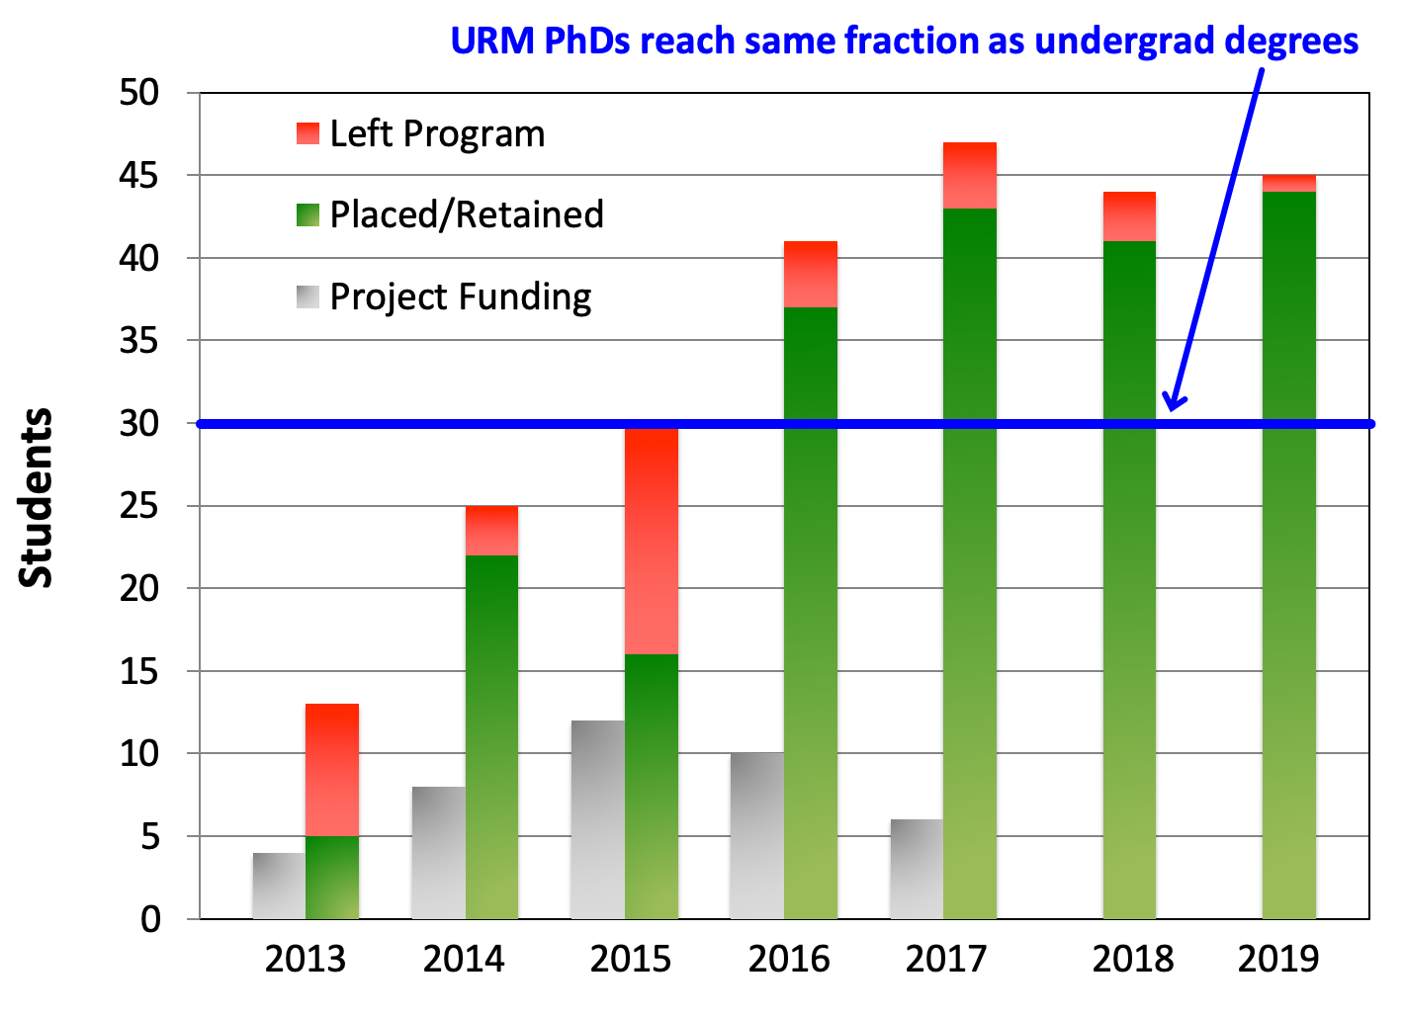

APS Bridge Program
Goal: to increase the number of URM students earning a PhD in physics
Connects URM students who were not admitted to physics graduate programs with supportive physics departments; promotes best-practices in admissions, induction, mentoring, retention
www.apsbridgeprogram.org
Program Demographics: Bridge Program
  77% Retention rate
  93% URM
    African American, Hispanic, Native American
  30% Female
Outcomes: 250+ Bridge students placed into physics graduate programs. First PhD Graduates in 2019 (2) and more expected in 2020.
This material is based upon work supported by the National Science Foundation under Grant Nos. 1834540 and 1143070. Any opinions, findings and conclusions or recommendations expressed in this material are those of the author(s) and do not necessarily reflect the views of the National Science Foundation (NSF).

Slide 4
Bridge Programs: Erasing
Disparity in Degree Attainment
IGEN has over 50 partner departments
250+ students
Physics, Chemistry, Materials Science, Astronomy, Geoscience
IGEN recruits underrepresented students for departments
Workshops / National Meeting on Inclusive Practices
Call to action: Apply to become a Partner department. More info, and a quarterly newsletter:
IGENetwork.org
Notes:
Graphic indicates % of UREM students receiving BS (Blue) and PhD (Red). Numbers indicate additional required annual PhDs to close the gap. Physics has met this goal.

Slide 5
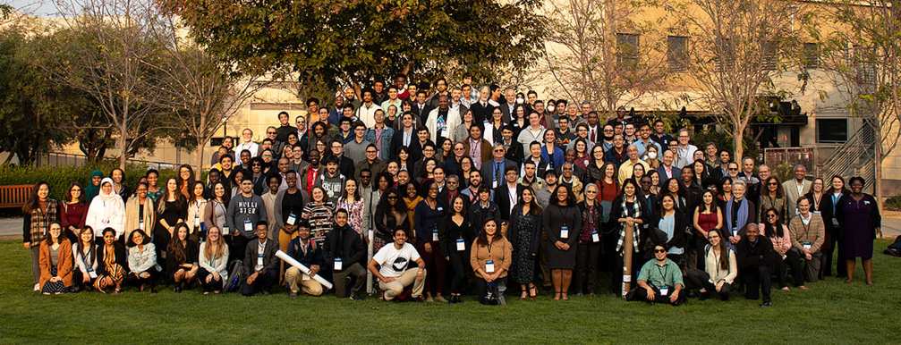
Mission: To increase the number of underrepresented ethnic and racial minorities who complete a physics BS degree
Program components:
  Pair undergraduates with local faculty mentors
  Annual conference
  Discussion prompts
  Workshops/PD
  BEAM fund
Join: www.aps.org/nmc

Slide 6



APS Inclusion, Equity and Diversity Alliance (APS-IDEA)
Vision: As a result of collective efforts, physics and related fields will become more inclusive of all social identities, with a diversity reflective of the nation, and with an equitable distribution of opportunities and resources.
Mission: APS-IDEA seeks to empower and support physics departments, laboratories, and other organizations to identify and enact strategies for improving equity, diversity, and inclusion. It will do so by establishing a community of transformation.
Guiding Principles
  Center people whose identities are marginalized
  Utilize sensemaking, supporting learning from mistakes
  Start with research-based change-management methods
  Shared leadership that spans the range of social power
go.aps.org/aps-idea

Slide 7
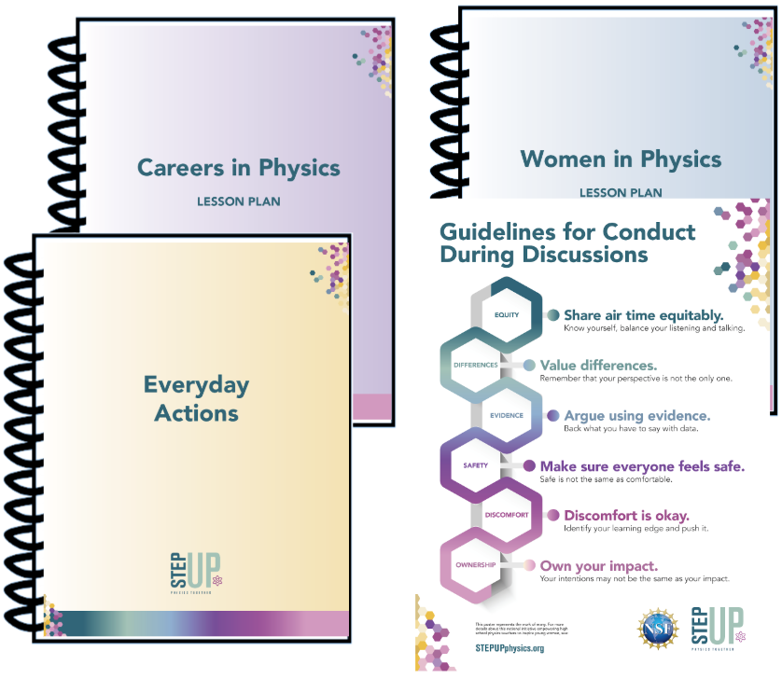
STEP UP: Building Inclusive High School Classrooms
Building a movement: 1,000 high school physics teachers
Critical juncture: reaching students when they make decisions on what subject to study
Research-validated lessons: shown to increase women’s interest in physics
Twice as effective at encouraging students of color to consider majoring in physics
Call to Action: We need more teachers!! Contact a local high school teacher, invite them to join at:
STEPUPphysics.org
Notes:
STEP UP
STEP UP (Supporting Teachers to Encourage Pursuit of Undergraduate Physics for Women) is a joint effort of APS, AAPT, and two research universities (Florida International University and Texas A&M University Commerce) to increase the participation of women in undergraduate physics. The project has developed a research-inspired and validated curriculum that taps high school teachers to create inclusive physics classrooms that support and encourage women.
STEP UP has evidence that this strategy, effective with women, is doubly effective at encouraging students of color to also consider and pursue undergraduate physics education – a result that has not been seen elsewhere in any other approach.
The project, in its first year of propagation, has recruited 1,000 high school physics teachers (of the ~27,000 teachers of physics in the U.S.) to form a national movement that provides ongoing support for the implementation of classroom strategies and lessons that promote equity and actively work toward reducing the disparities in participation of women and UREM students in physics.
Call to Action: Speak to your local high school teacher, and ask them to join the community. Strategies and more information available at: http://STEPUPphysics.org

